Slide 1

Sprint -1

Slide 2
Sprint Goals
Brainstorming the Project
Finalizing the Project
Requirements Gatherings
Deciding each module, phases, and technologies to be used in the project.

Slide 3
Sprint Backlog
Sprint Task | Module | Priority | Issue encountered | Status
Sprint -1 Task -1 | Brainstorming Idea | High | No Issue | Completed
Sprint -1 Task -2 | Requirements Gathering | High | No Issue | Completed
Sprint -1 Task -3 | Login Details page | High | No issue | completed

Slide 4
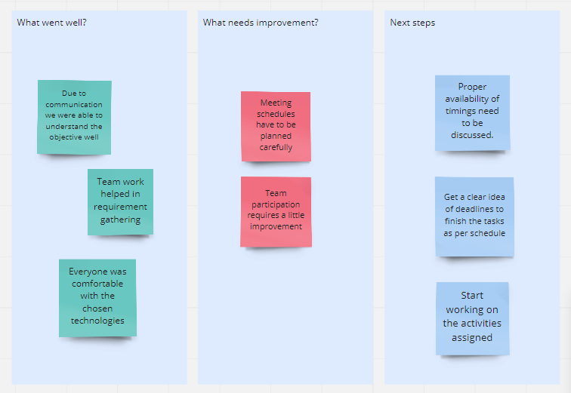
retrospective

